Slide 1
What do we know? How do we know it?
Introduction to Philosophy
Philosophy 100
Class 5

Slide 2
Epistemology: The Study of Knowledge
Questions in epistemology:
What can we know?
How do we know?
What does it mean to know?
In the next three classes we consider the first two questions, and then we will analyze what “knowledge.”

Slide 3
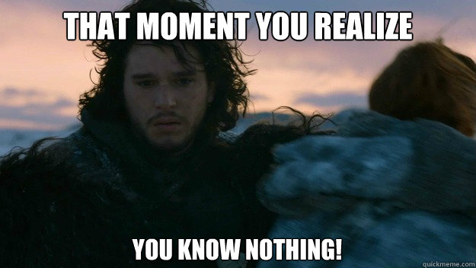
Skepticism Overview
What does “skepticism” mean?
To be skeptical is to doubt that we have knowledge.
Can we avoid Skepticism?

Slide 4
Rationalism vs. Empiricism
How it is that we can come to know things?
Historically there have been two camps on this issue.
The Rationalists
The Empiricists
Some propositions can be known a priori, through reason alone, and not through sense experience.
Knowledge is solely a posteriori, which means all knowledge in S or for the concepts we use in S derives exclusively from sense experience.

Slide 5
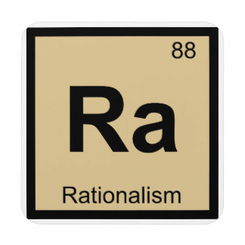
Rationalism
Reason is the primary source of knowledge
Sense experience is an unreliable and inadequate source for knowledge
The fundamental truths of the world are knowable a priori: they are either innately known, or they are self-evident to our minds

Slide 6
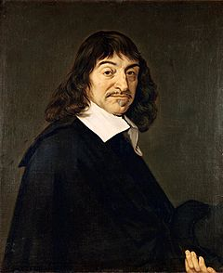
Rene Descartes (1596 – 1650)
Father of Modern Philosophy
Philosopher, Mathematician, Scientist, Teacher
One of his main contributions to philosophy is his defense of rationalism, which breaks from the previous generation of scholastic philosophers
Held that knowledge required certainty

Slide 7
Methodological Doubt
Descartes worries that we can too easily be shown wrong in those things that we think we know. So he asks:
What can I know with certainty—what can I know that cannot be doubted?
Descartes believes that if he can answer this question, he will then be able to discover the basis for how we know everything else.

Slide 8
In order to answer his main question, Descartes engages in a method of doubt:
Anything that can be doubted, will be assumed as wrong.
If we can discover something that cannot be doubted, then we have a basis for knowledge.

Slide 9

Step 1: Perceptual Doubt
We can be mistaken when we look at distant objects.
Visual illusions are not uncommon.
Contemporary psychology has shown this to be true even as a state of our minds.
So, perception-based beliefs can be doubted.

Slide 10
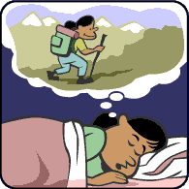
Step 2: External World Doubt
Even if we take great care when observing the world through our senses, how can we tell we’re not in a dream?
This question is similar to the simulation argument.
So, all sense-based knowledge of the external world can be doubted.

Slide 11
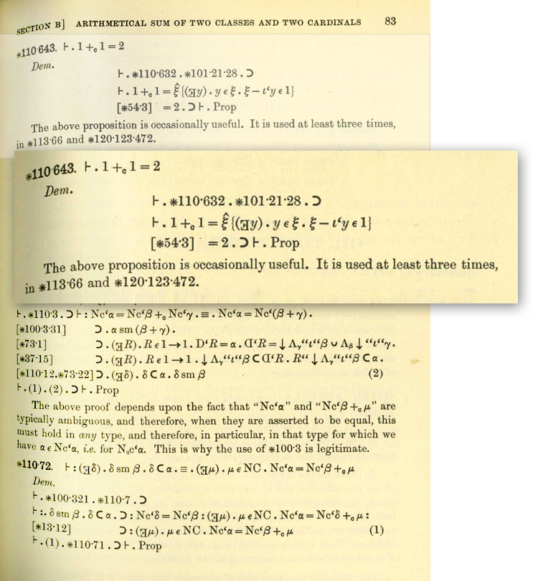
Step 3: A priori Doubt
Mathematical truths seem like something we can know with certainty. But what if the world was set up such that 2 + 2 = 5? How would you know this, especially if you’ve always made the same mistake?
That more complicated proofs can illicit fallacious inferences is obvious, so there is no guarantee that these types of beliefs will be true.
So, we can even doubt a priori reasoning.

Slide 12
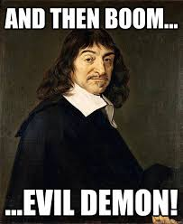
Step 4: Hyperbolic Doubt
Since we can doubt all modes of knowledge, and in order to desist in our habitual way of thinking, we should attempt to cast the widest breadth of doubt we can.

Slide 13
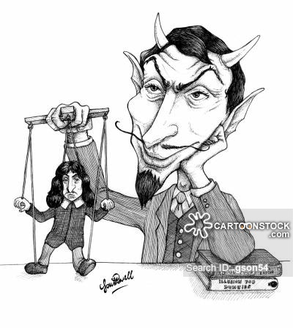
Descartes Misleading Demon
We will adopt the notion that a malicious demon is deceiving us about all beliefs about the external world and a priori truths.
We can thereby doubt pretty much everything!

Slide 14
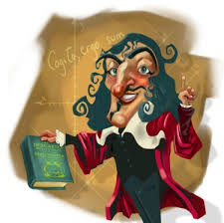
What Can’t We Doubt?
Cogito ergo sum!
I am being deceived.
If I am being deceived, I am thinking.
Thinking requires the existence of a thinker.
I think.
Therefore, I exist.
We cannot doubt our own existence

Slide 15
Reason over experience
Since “I exist” cannot be doubted, and we learned that from just sitting and thinking about it and not from sense experience, we have reason to think that a priori knowledge is much stronger than sense-based knowledge.
Therefore: RATIONALISM

Slide 16
One problem for Descartes an aside on circular reasoning
Reconsider this argument:
I am being deceived.
If I am being deceived, I am thinking.
Thinking requires the existence of a thinker.
I think.
Therefore, I exist.
What about:
Something is being deceived.
If something is being deceived, something is thinking.
Therefore, thinking exists.
Thinking requires the existence of a thinker.
Something thinks.
Therefore, something exists.

Slide 17
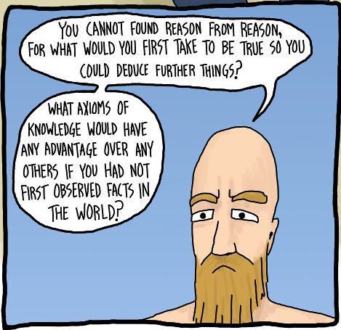
Empiricism
All knowledge of a subject or of concepts pertaining to a subject begin with experience.
Empiricism does not entail that we have knowledge. It entails that knowledge can only be gained, if at all, by experience. Empiricists may assert that the rationalists are correct to claim that experience cannot give us knowledge. The conclusion they draw from this rationalist lesson is that we do not know at all.

Slide 18
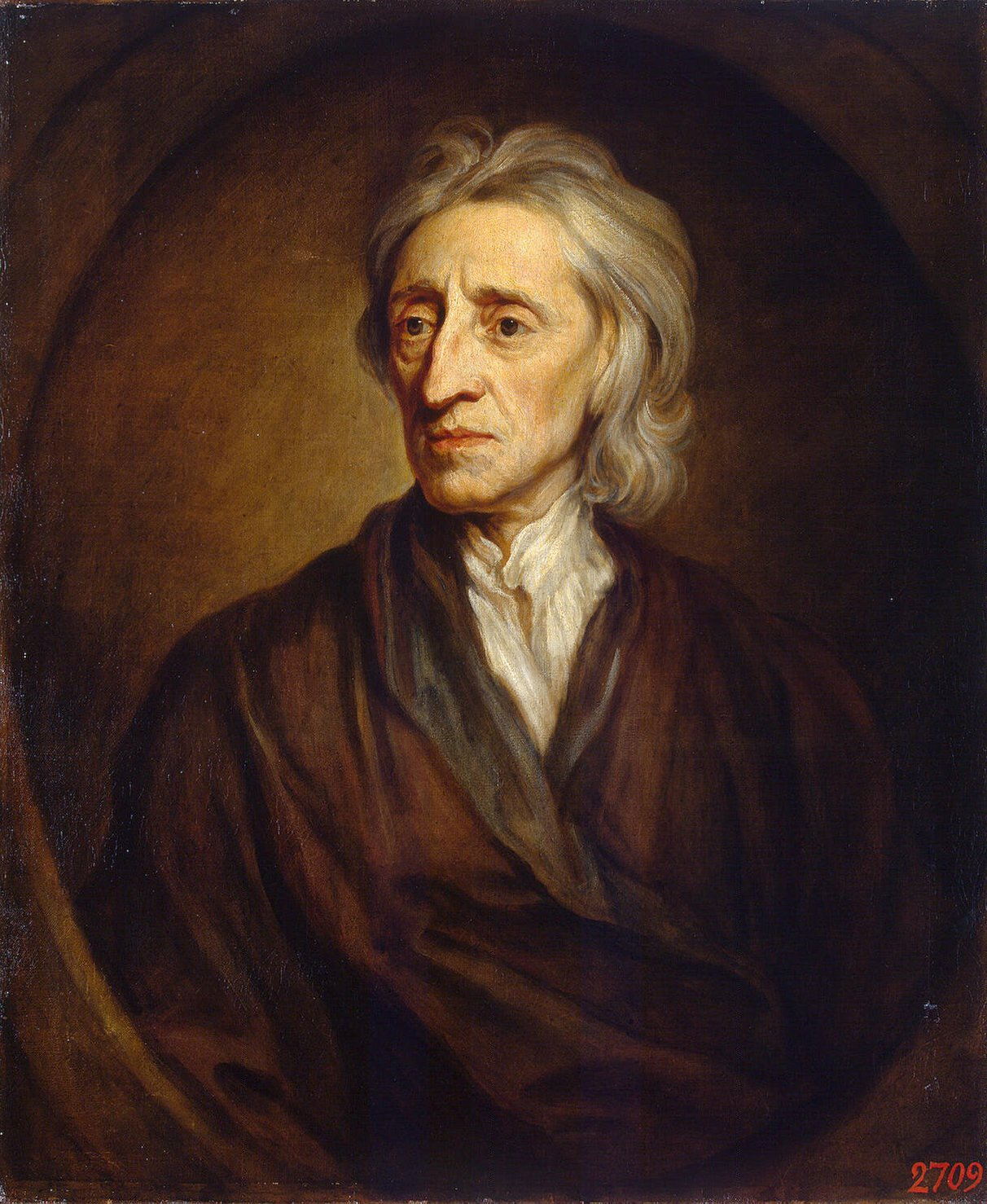
John Locke (1632 – 1704)
British Philosopher
Studied law, politics, philosophy, and science
Is a staunch empiricist and also contributed significantly to contemporary political theory.

Slide 19

Tabula Rasa
The mind is a blank slate prior to any experiences.
We need experience to fill our slates.
These experiences produce ideas.

Slide 20
Locke’s Ideas
An idea is the immediate object of thought, understanding, or perception.
Primary Qualities
Secondary Qualities
Those qualities that cannot be taken away from an object—that are intrinsic to the object itself: solidity, extension, figure, mobility, and number.
Those qualities that are not in the object themselves, but that the primary qualities produce in us: colours, sounds, tastes, etc.
IDEAS ARE NOT INNATE

Slide 21
We can infer that there are insensible primary qualities on the bases of sensation organizing things into perceptual unity.
The brain organizes the imperceptible primary qualities of an object by those objects causing the perception.
This is also how we get secondary qualities: they are caused by the external object affecting our sense modalities.

Slide 22
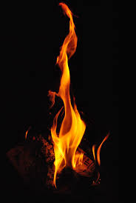
Secondary Qualities
These qualities are in us only and not in the object. But they are cause in us by the object: warmth or blueness or sweetness is only the primary qualities of an object being produced in us.
Consider the difference between the warmth of a fireplace and burning one’s hand in the fire. We don’t say the warmth or the pain is in the fire.

Slide 23
Main Point: We need experience
Although the mind responds to the world in a way that cannot actually describe the world as it is, we need the world to know things.
For example, we cannot know that fire has primary qualities that will produce in us a burning sensation by merely thinking about fire.
We cannot doubt the existence of a table, e.g., any more than we could doubt our own existence.

Slide 24
The external world is the cause of our experiences, our mind/senses are not.
Try observing colour in the dark, for example.
Our sensations are coherent; their consistency confirms each of them independently.
All of what we know comes from sensation and making connections.

Slide 25
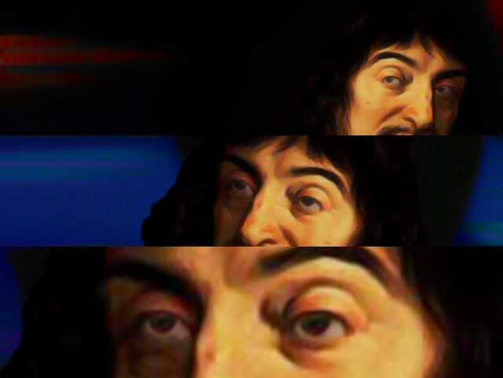
Locke’s Response to Descartes
Descartes’ method of doubt is wrong on a number of fronts.
We couldn’t even know to doubt if we didn’t already have the testimony of our senses, which requires an external world cause.
Our faculties are there for us to navigate the world successfully, not have perfect clear knowledge.

Slide 26
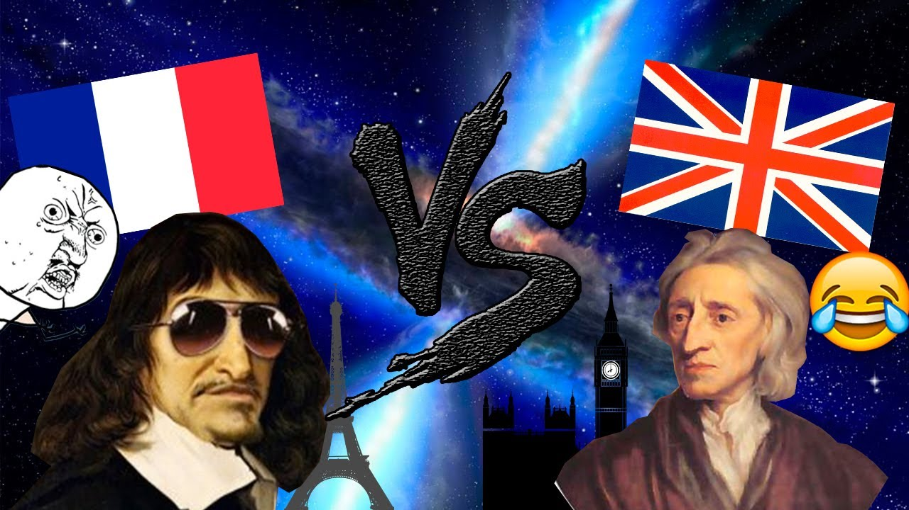
Descartes vs. Locke
Since “I exist” cannot be doubted, and we learned that from just sitting and thinking about it and not from sense experience, we have reason to think that a priori knowledge is much stronger than sense-based knowledge.
Therefore: RATIONALISM
Although the mind responds to the world in a way that cannot actually describe the world as it is, we need the world to know things. All of what we know comes from sensation and mental connections.
Therefore: EMPIRICISM

Slide 27


